Slide 1
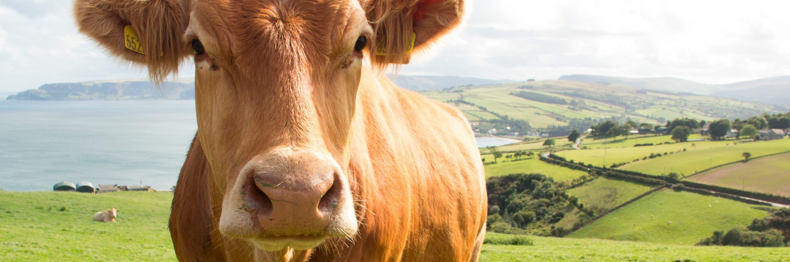

COMPRESSION AND OPTIMIZATION IN THE LIVESTOCK FARMING CONTEXT

Slide 2

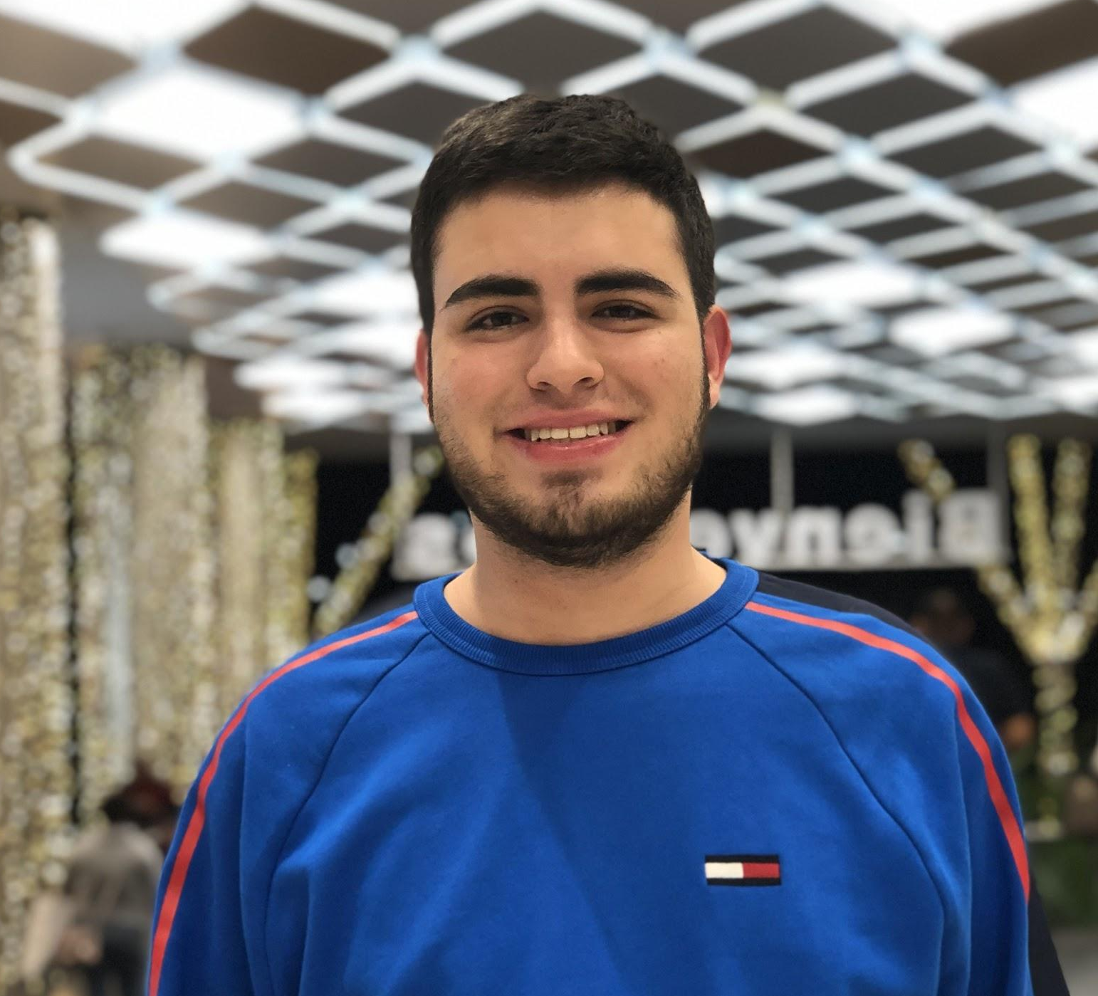
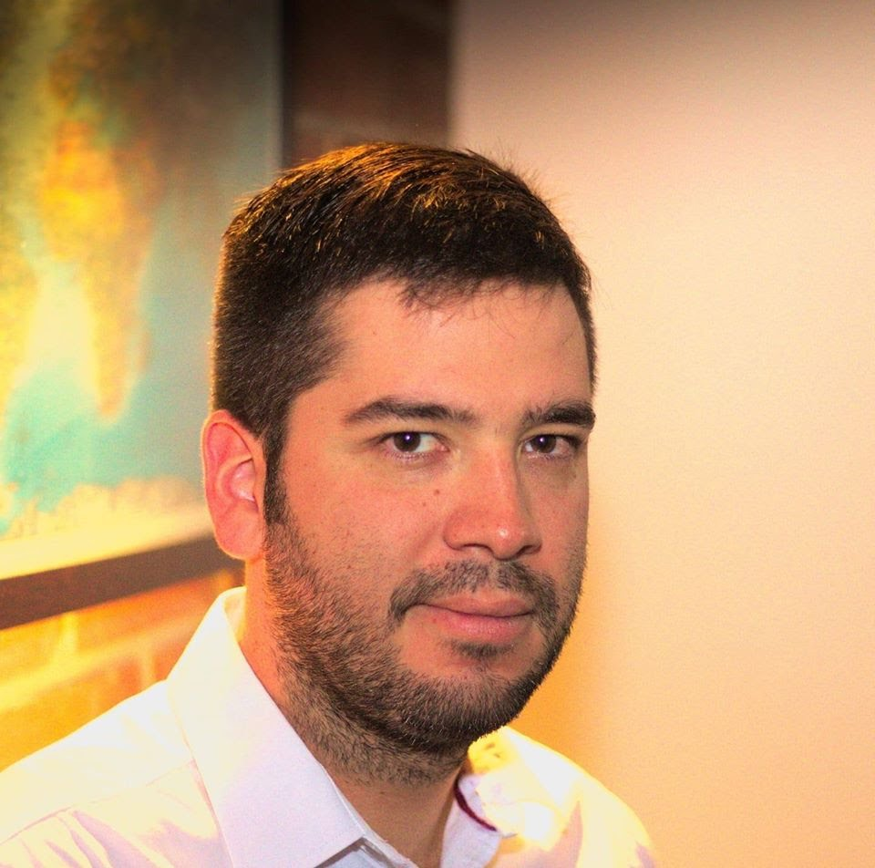
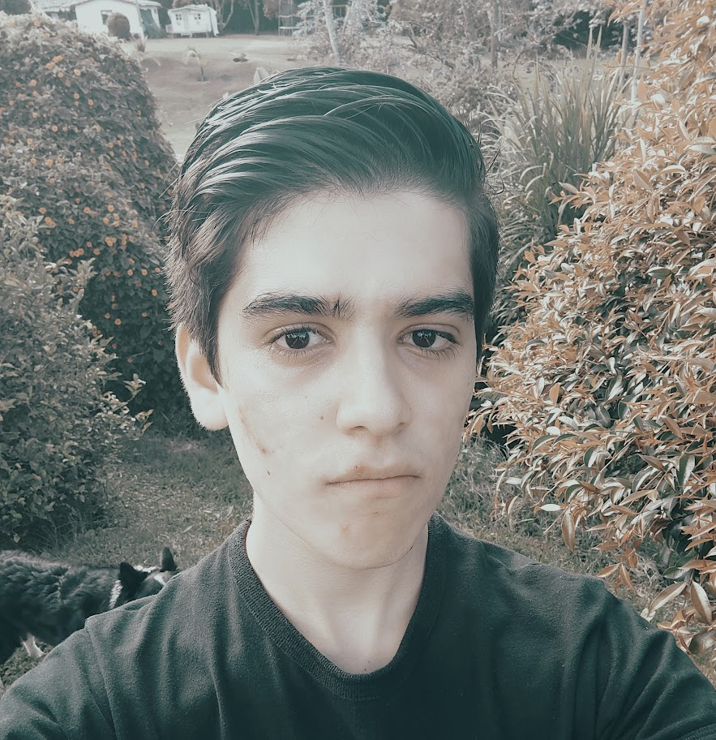
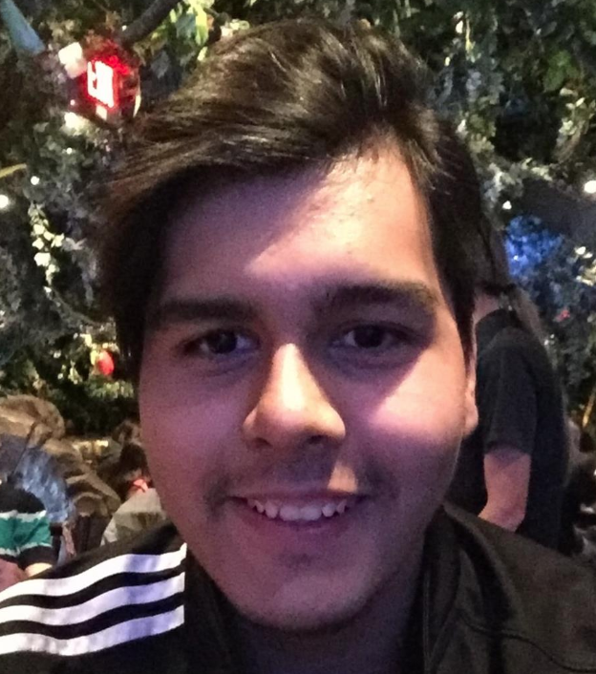

Team Presentation
Santiago
Lenis
Julián
Peña
Simón Marín
Mauricio
Toro
https://github.com/AlterBiscuit/ST0245-001

Slide 3
THANK YOU!.
Supported by
The first two authors are supported by a Sapiencia grant financed by Medellín municipality. All the authors would like to thank the "Vicerrectoría de Descubrimiento y Creación", of Universidad EAFIT, for their support on this research

